Slide 2
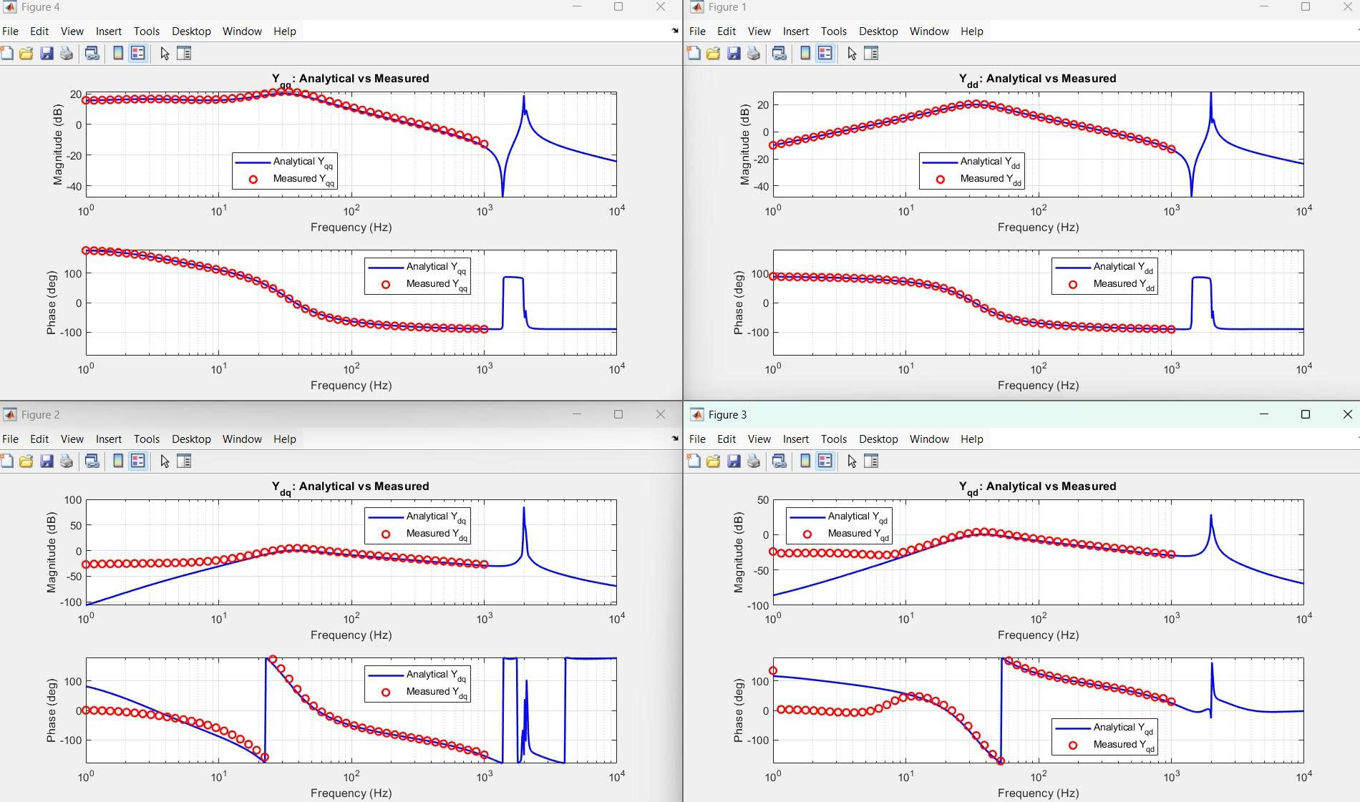

Slide 3
Kpi,Kii=0.85Kpi,Kii
Kppll,Kipll=0.5/0.75Kppll,Kipll
GFLI_L
GFLI_L(Lf1+Lf2)

Slide 4
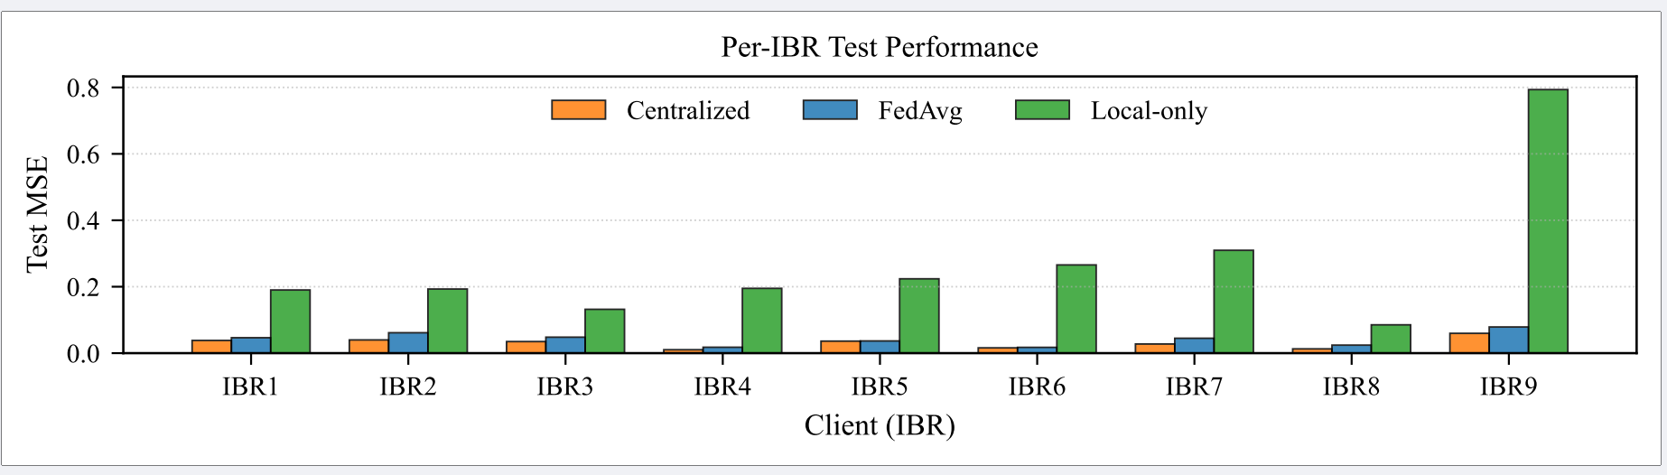
Case 4: Evaluation with Black-Box EMT Measurement-Based Data
Create a table for comparison under different noise levels

Slide 5
Case 5: Evaluation with different non-IID levels
Create a table with different hyperparameters (vertical) and test MSE for different non-IID levels (Small variation in parameters, larger variation, and different IBR structure (L-filter))

Slide 6
Case 6: Application of the estimated admittance models to IBR–grid small-signal stability analysis.
- Create a table: including multiple operating points (vertical), multiple error levels (from previous scenario(non-IID/noise)) => Stability decision and add some more EMT validation

